Slide 1
Changing CULTURE BY LEVERAGING DEVOPS PRINCIPLES TO INCREASE FLOW.

Slide 2
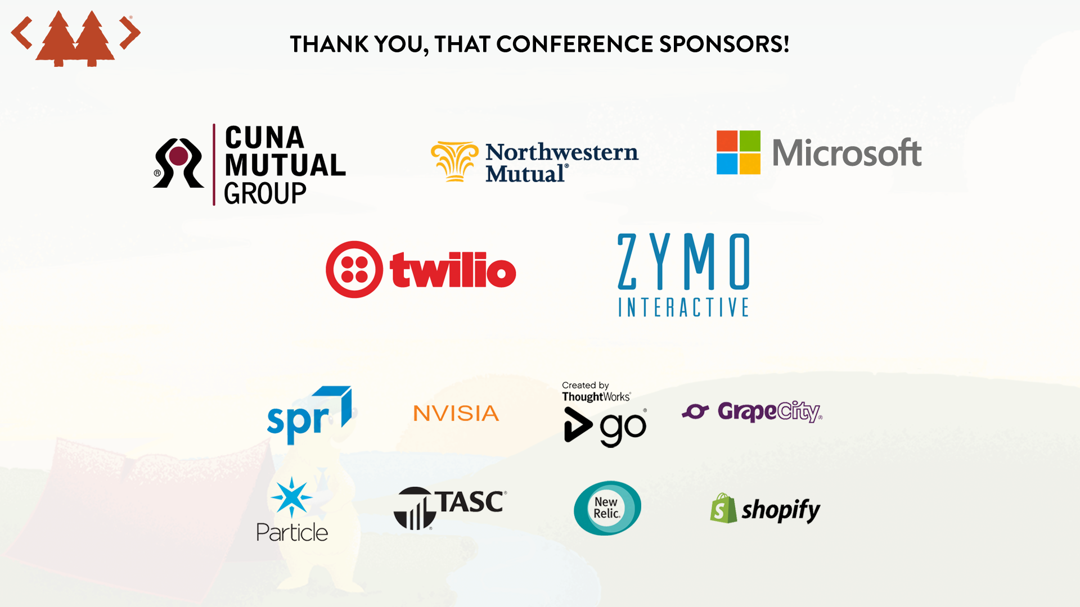

Slide 3

Presenter
Matt Frye
Portfolio Solutions Architect
CUNA Mutual Group
Email
Matthew.frye@cunamutual.com
Twitter
@frye_matt

Slide 4
Presenter
Jennifer Drangstveit
Senior IT Manager
CUNA Mutual Group
Email
Jennifer.Drangstveit@cunamutual.com

Slide 5
Join us at Open Spaces following this talk (1:00 PM) to continue the conversation!

Slide 6
CUNA Mutual Group
INTERNATIONAL INSURANCE, INVESTMENT, AND FINANCIAL TECHNOLOGY SOLUTIONS PROVIDER
80+
TRUSTED COMPANY
YEARS in risk management
Helping people achieve financial security
95%
FINANCIALLY STRONG: $3.5 BILLION REVENUE
of credit unions are our customers
A
A.M. Best Company¹
A2
Moody’s Investor Services²
A
Standard & Poor’s Rating Services³
3,300 EMPLOYEES worldwide ––– Headquarters: MADISON, WI
#2 MOST REPUTABLE INSURANCE COMPANY IN U.S. on Reputation Institute’s 2017 U.S. Insurance RepTrak® list
$1.33 BILLION benefits paid in 2017
1 A.M. Best Company, March 2018, 2 Moody’s Investor Services, February 2016, 3 Standard & Poor’s Rating Services, September 2017

Slide 7

Our Journey – A Case Study from CUNA Mutual Group
Culture
Automation
Lean
Measurement
Sharing
Notes:
Culture
Embrace a high trust culture to drive change, communication and collaboration
Automation
Take manual steps out of the value chain
Lean
Use Lean principles to enable higher cycle frequency
Measurement
Measure what’s important and use data to refine cycles
Sharing
Share experiences, successful or not, to enable others to learn

Slide 8
Liger Team Mission:
Our mission is to design, develop, and deliver application platform solutions, collaborating with Lending capability teams, to deliver business value more efficiently with quality and reliability.
C
(→ Chef
← training, automated services )
→Enterprise Service, New to Enterprise
← training, automated services
Scrum Team
Tiger
If work shifted right, goal is to teach it or automate it and shift left
Why does work shift right when goal is to shift left?
Skill/Access (separation of duties)
Capacity
Building a shared/enterprise service

Slide 9
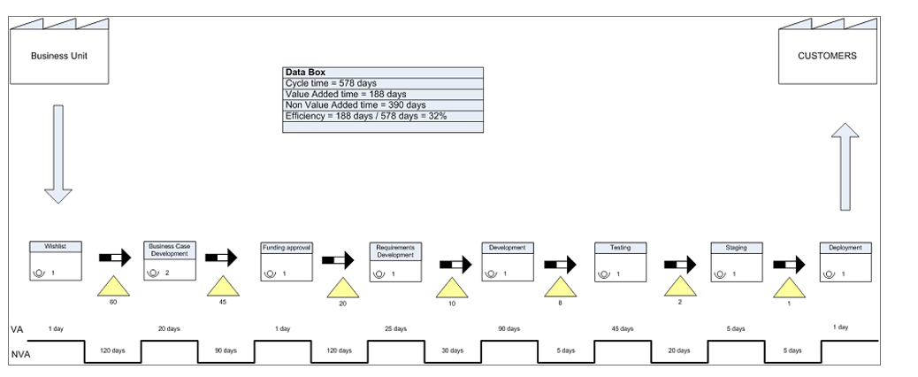
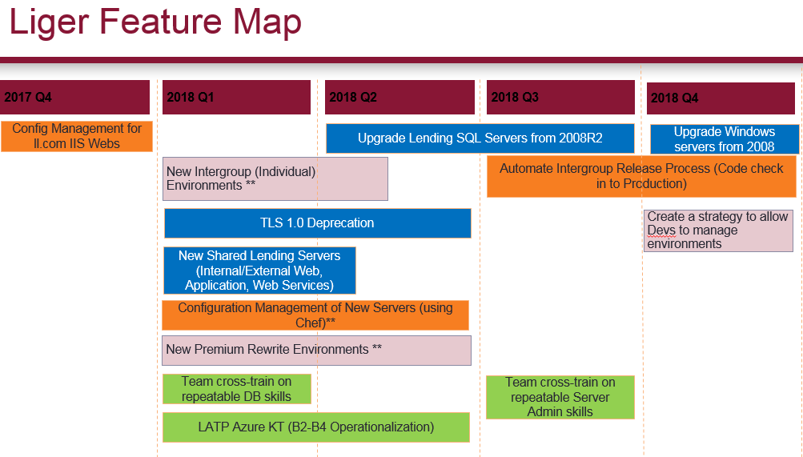
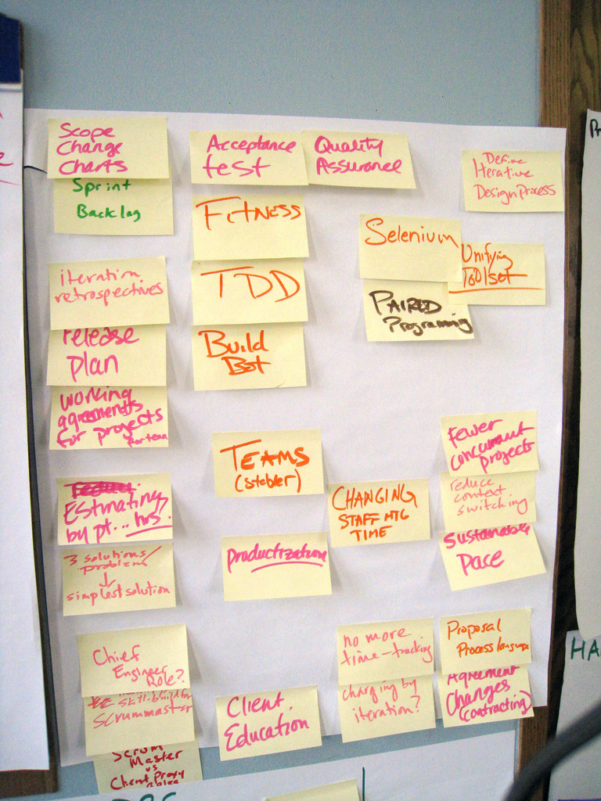
Value Stream Mapping – Use data to increase Flow
L
1
3
2
Notes:
Used Lean principles – eliminate waste; watch work flow through the system
Worked with Consultants (Break Free) to learn the Value Stream Mapping process. Explain VSM.
Analyzed one of our team’s work which helped us build our feature map. Bottlenecks identified.

Slide 10
Automation Is Key
A
Environment mirroring
Reusable – Public Cloud builds, new environments
Continuous monitoring
Reporting of compliance failures
Shift left
Enable scrum teams
Culture Change
MVF approach, cross functional, lean practices, software defined
Notes:
VSM -> Configuration Management of Web Servers
The team’s ability to swarm and focus on the environment led to the decrease in WIP/overall time (lack of tickets)
Turned off the ticket queue to analyze trends/gather data to produce metrics
This metric shows how impactful this can be. Here’s others and why it’s important to capture that data…

Slide 11
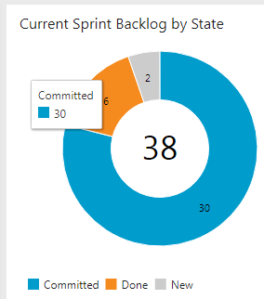

Measure Everything Always
M
Team Happiness
SHIFT LEFT

Slide 12
Sharing what’s learned
S
Quick, effective communication is important
Problem-solving attitude
Flexibility
Team Building
Notes:
Team uses Slack; co-locates nearly 100%
Team cohesion is essential
Sprint Reviews
Used Visual Studio Live Share
Created a Wiki (vs. Sharepoint or OneNote)
Team takes on new challenges to area and company so we need people who think on their feet
We support 7 different teams and work on automation efforts. We need flexibility to handle incoming work. Add points to sprint for support.
Internal User Groups
Community of Practice
IT Executive Leadership
Open Spaces

Slide 13

Our Challenges - Would love to hear if you have solved them!
Separation of Duties
Prioritization
Capacity Planning
Funding – UGH!
Pairing
Who are we and what do we do vs other teams? (ie Tiger, scrum teams,)
Constantly inspecting/adapting team – who wants to be on a team like this?
How do we scale? Do we expand this model?
How do we disperse the knowledge for the gain of the company?
How do we keep our toolsets under control?

Slide 14


Slide 15
Who wants a 4K monitor?

